Slide 1
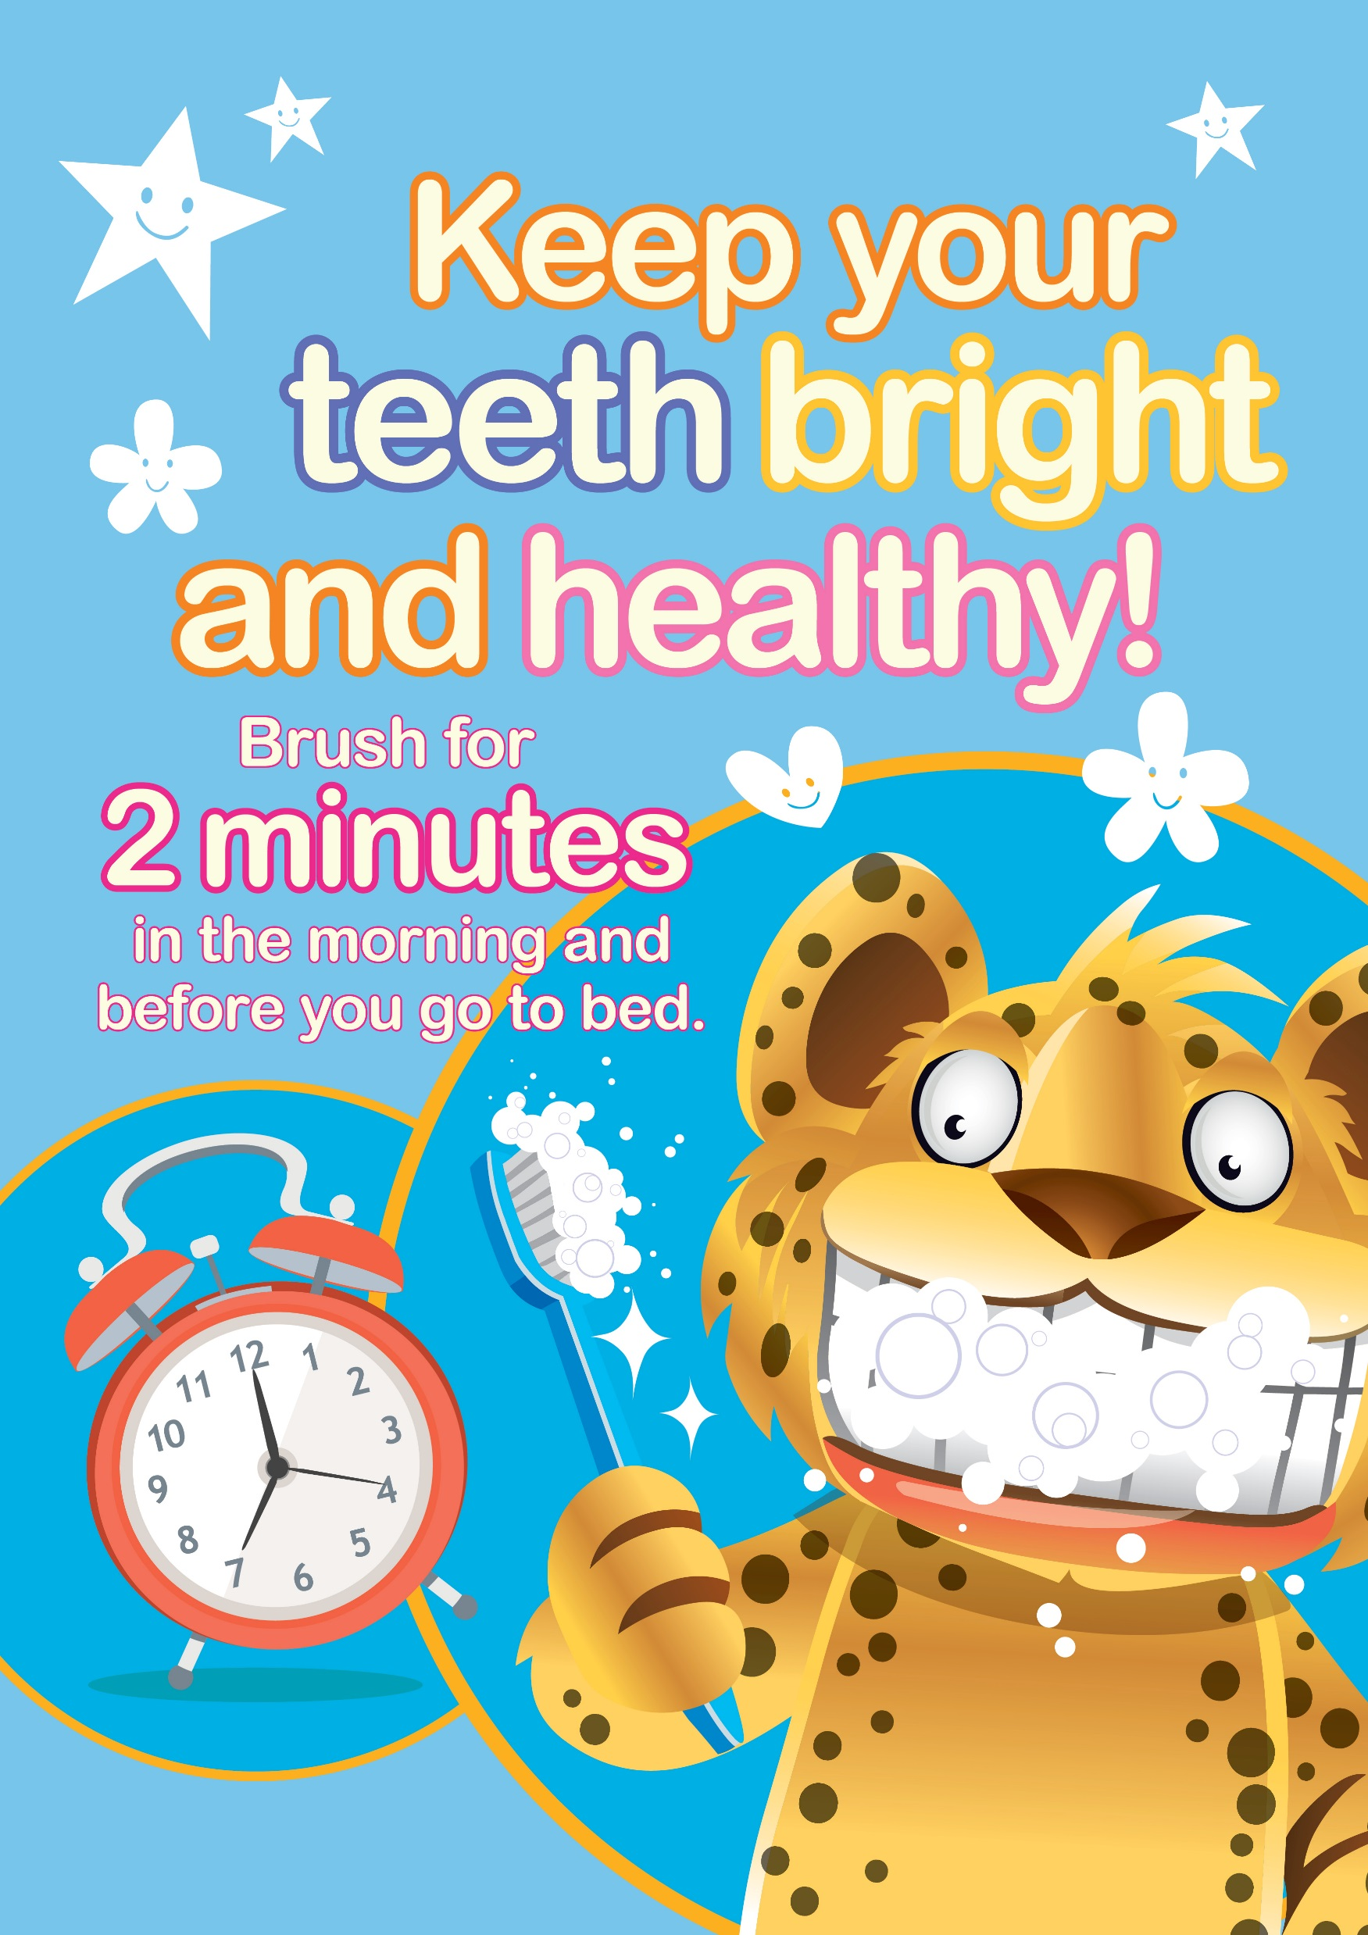
Lympstone Preschool’s guide to promoting child oral hygiene & healthy eating.

Slide 2
Promoting child oral hygiene & healthy eating
Did you know?
Tooth decay is the most common oral disease affecting children and young people in England, yet it is largely preventable.
The oral health survey of 5 year olds in 2017 showed that just under a quarter have tooth.
Each child with tooth decay will have on average 3 to 4 teeth affected.
For those children at risk, tooth decay starts early. The first survey of 3 year olds in 2014 found that 12% had visible tooth decay, with on average 3 teeth affected.
Almost 9 out of 10 hospital tooth extractions among children aged 0 to 5 years are due to preventable tooth decay.
Tooth decay can cause problems with eating, sleeping, communication and socialising, and results in at least 60,000 days being missed from school during the year for hospital extractions alone.

Slide 3
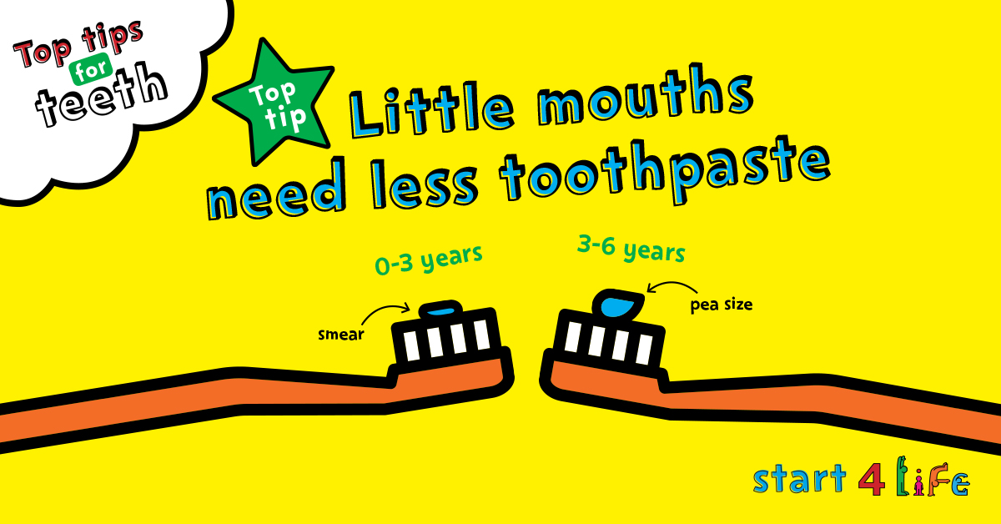
Prevention
What you can do to help.
Tooth decay could be prevented by cutting down on sugar, as well as brushing teeth with fluoride toothpaste. The cost to the NHS of treating oral conditions is about £3.4 billion per year.
Encourage regular tooth brushing. Keep your children’s teeth bright and healthy by brushing for two minutes in the morning and before they go to bed. Remember to spit, don’t rinse!
Encourage healthy eating and drinking, avoid sugary drinks and snacks

Slide 4
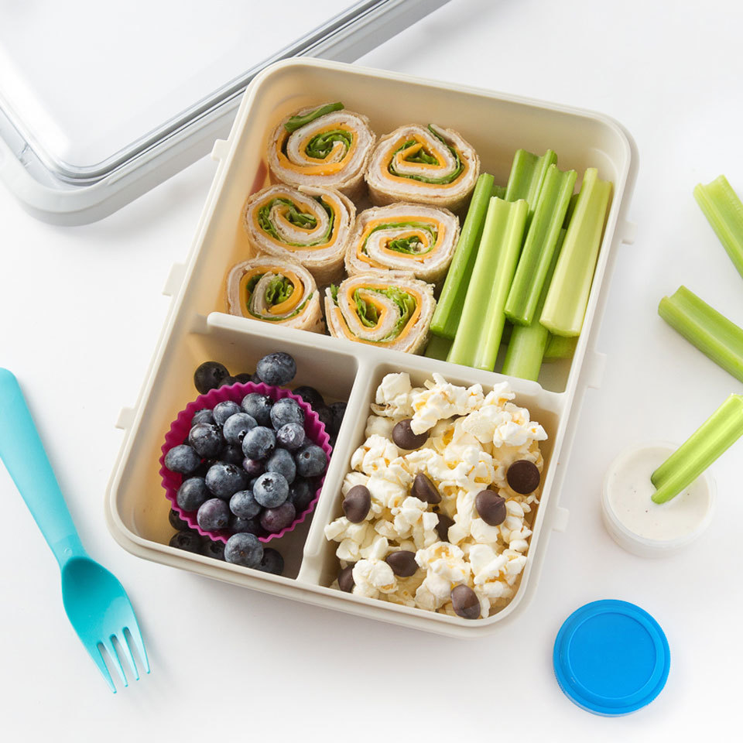
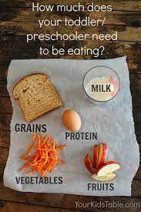
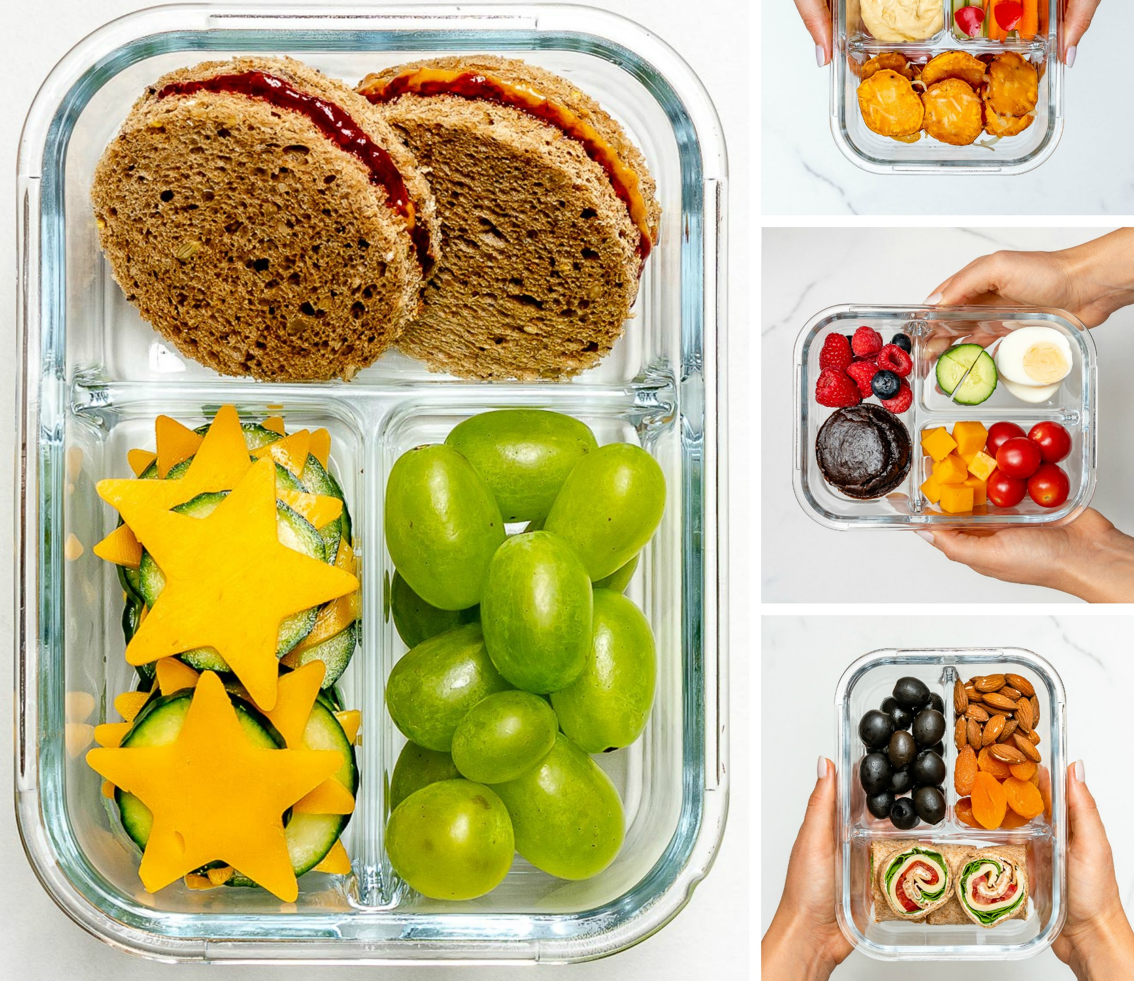
Healthy eating examples
Children are happier choosing from a small range of foods. If your child seems to pick just one or two favoured things every day, this is not unusual – gradually introduce more options but be prepared to be patient.
Involve your child in planning and preparing their lunchbox – kids are more likely to try foods that they’ve been involved in selecting and making. Make this an interesting and fun activity, so that they want to get involved.
Avoid too many sweet snacks, try to keep a sweet and savoury balance. Sweet is a treat!

Slide 5
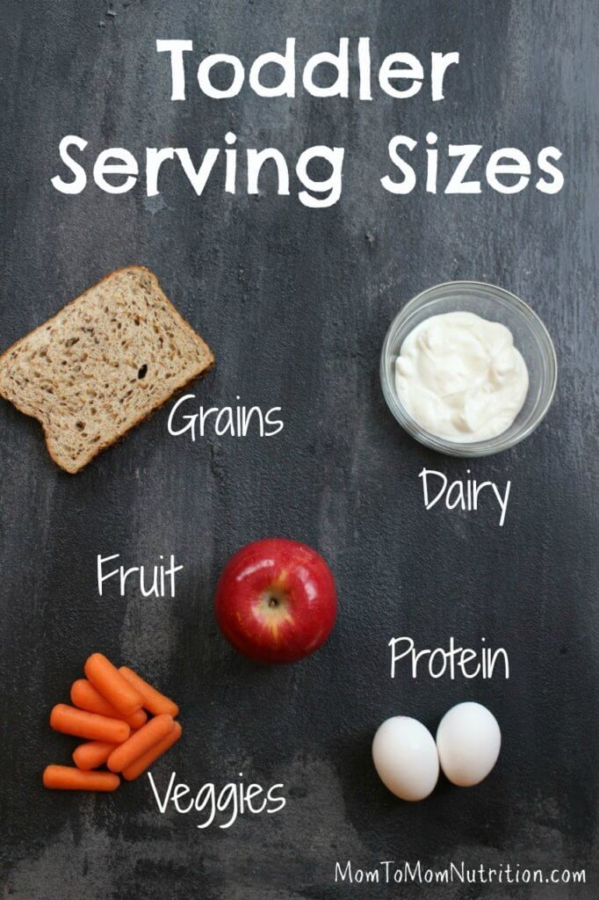
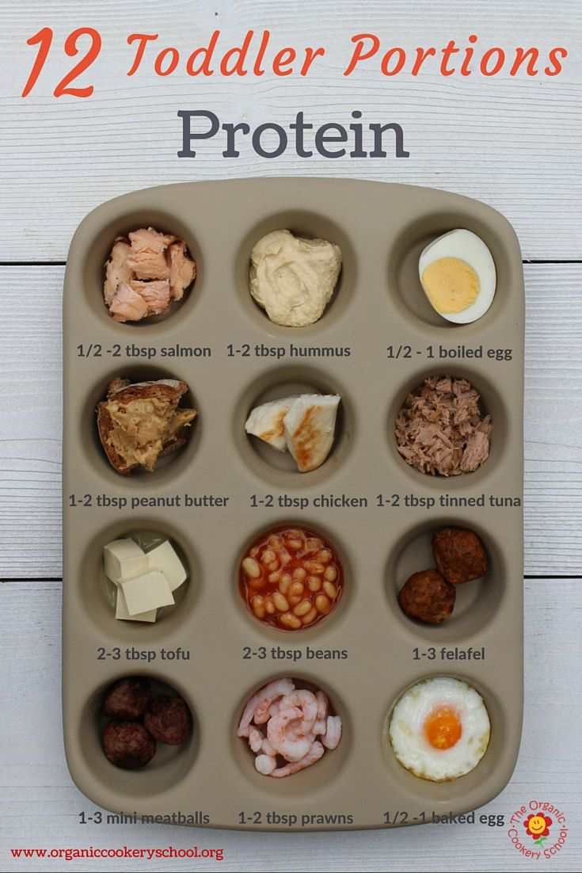
Healthy eating examples
Dairy - Yogurt/fromage frais, child-sized pots vary from 50-100g. Hard cheese like cheddar, approximately
Calcium – its essential for bone-building. Good sources are milk, cheese, yogurt and fromage frais, as well as green leafy veg
Protein - This is important for helping your child to grow. It will also keep them feeling fuller for longer.
Fruit & Veg - At lunch include at least one portion of fruit and one of veg or salad.
Starchy carbs - Such as bread, noodles, pasta, rice or potatoes. These are important for energy and should make up a third of their lunchbox

Slide 6
Children’s Lunchbox Ideas
Day | Pick a carb | Pick a Protein | Pick a fruit | Pick a veg | Extra Energy
Monday | Wrap | Chicken | Apple | Lettuce & Avocado in the wrap | Yoghurt
Tuesday | Sandwich Thin | Tuna | Grapes | Sweetcorn with the tuna or on the side | Cheese
Wednesday | Pitta | Hummus | Orange | Carrot Sticks | Malt Loaf
Thursday | Sliced bread | Cheese | Tinned Fruit | Tomato and Cucumber | Dried Fruit
Friday | Pasta Pesto | Tinned Kidney beans or edamame beans | Mango | Peas, sweetcorn, pepper in pasta salad | Energy ball or muesli bar (nut free)

Slide 7
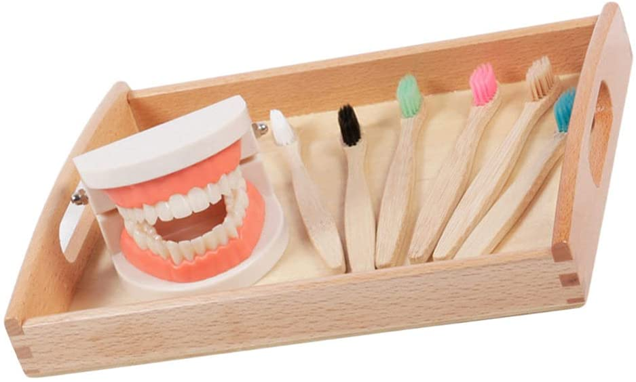
What we will do at preschool
Circle time with teeth and toothbrush model props
Reading and sharing stories
Discussion and snack and lunch time about the importance of healthy eating and brushing teeth
Healthy snack time and breakfasts accompanied with either water or milk.
Teeth brushing related games.
Please share anything you do at home with us so we can add this to our discussions / show and tell.
References: https://www.gov.uk/government/publications/child-oral-health-applying-all-our-health/child-oral-health-applying-all-our-health https://teethteam.org.uk/parents/resources/sugar-advice.php https://yourkidstable.com/toddlerpreschooler-portion-sizes/ https://www.podandpeanutrition.org/

